Slide 1

ALUMNI MANAGEMENT SYSTEM
PROJECT PROPOSAL
Notes:
Introduction of Members

Slide 2
Connect
Notes:
Discuss this / In relation to Alumnus and University

Slide 3


There is no existing Alumni Management System
Statement of the Problem
The only communication of the alumnus to the school are through Facebook and messenger
Transactions that was made by an alumnus was only at paper and no record on cloud

Slide 4



Cons of the FB Group
Reliability
Security
Unorganized
1
2
3
Notes:
Relibility – Facebook group can be loss
Security – Dummy account can join
Unorganized – Facebook group is general purpose, not tailored to Alumni

Slide 5

Notes:
Introduce - Title

Slide 6
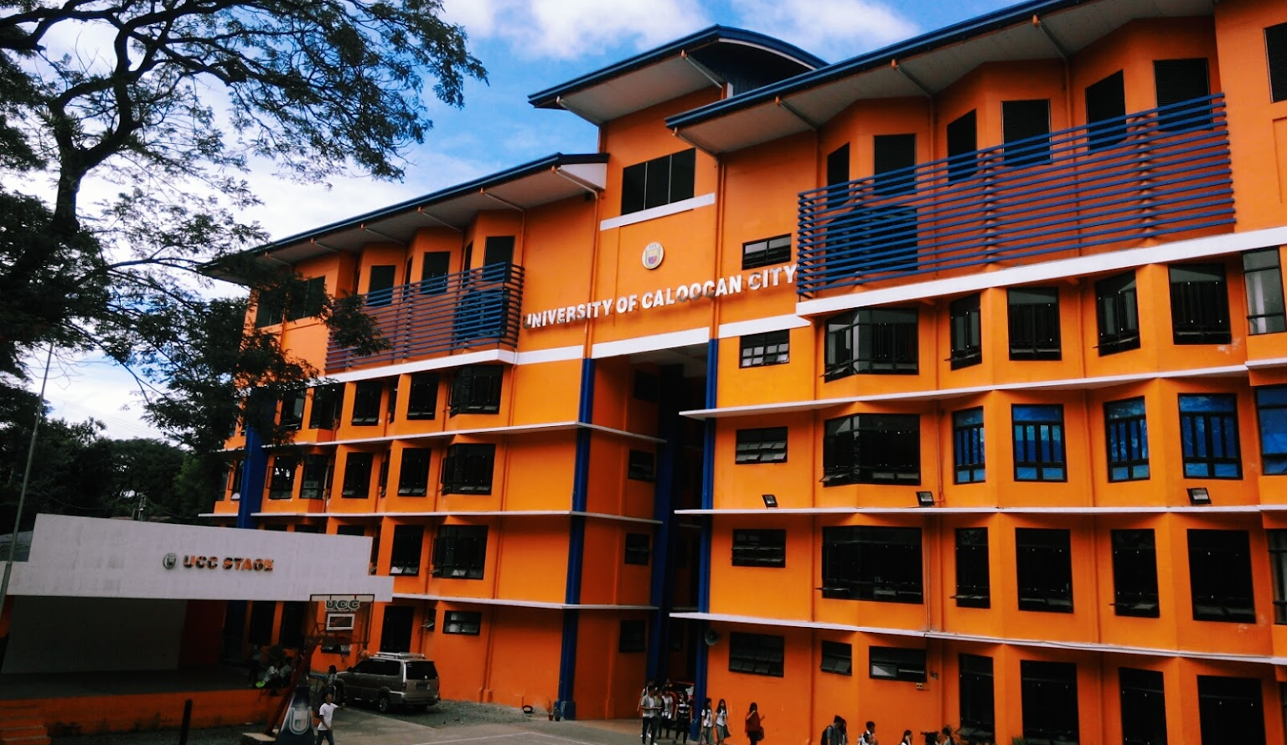

ALSPACE
A Social Media Platform for CSD Alumni
Notes:
Name subject to change
Discuss General Objectives

Slide 7
SPECIFIC OBJECTIVES
1. Create database system to keep all the files of the alumni.
2. Accommodate and provide information sheet and registration for alumni.
3. Provide security to alumni users in terms of malign issues.
4. Provide accurate and relevant records of alumni that can be easily accessed.
5. Provide information board for all alumni.

Slide 8
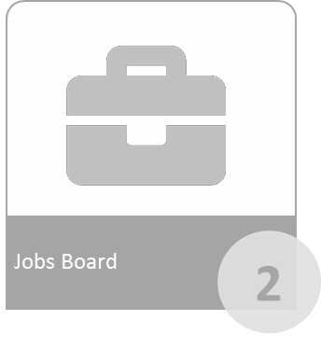






SYSTEM FEATURES
Event Management
Discussion/Forums
1
3
Member Accounts
Chat Support
Requesting for Items such as ID and T-Shirts
4
5
6

Slide 9
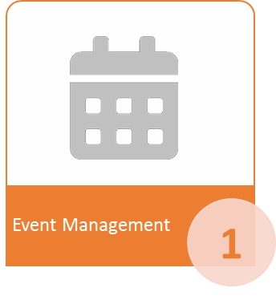
SYSTEM FEATURES

Slide 10
SYSTEM FEATURES

Slide 11

SYSTEM FEATURES

Slide 12
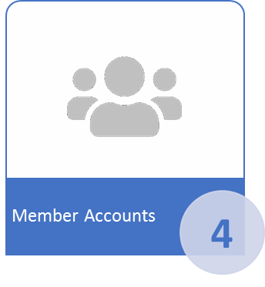
SYSTEM FEATURES

Slide 13

SYSTEM FEATURES

Slide 14
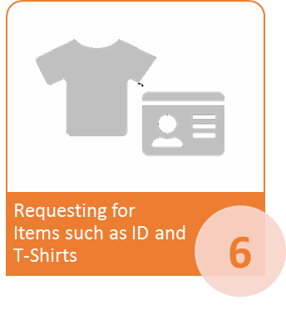
SYSTEM FEATURES

Slide 15
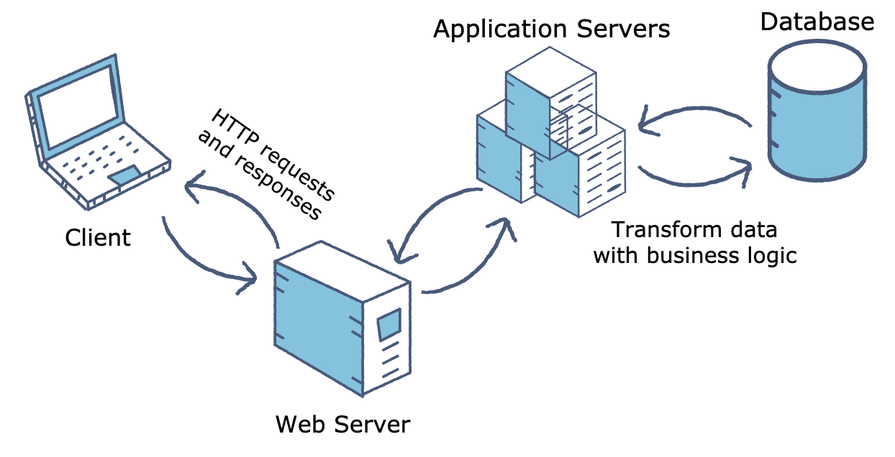
Deployment

Slide 16
BUDGETARY RISKS
Yearly Payment for:
- Domain Name
- Web Hosting

Slide 17
Warranty and Maintenance
One (1) year of warranty
Identified functions will be maintained.

Slide 18
Training and Support
15 hours personal training for Admin users.
Online documentation.
Chat Support from developers.

Slide 19




THANK YOU
Lenard Mangay-ayam
(Team Leader)
(+63) 948 537 9875
lenard.mangay-ayam@gmail.com

